Slide 1
Concepts of Boolean Algebra

Slide 2
Lecture 19 Standard Forms of Boolean Expressions
Lecture delivered by:
Deepak V.

Slide 3
Topics
Standard Forms of Boolean Expressions
Product-of-Sums (POS)
Implementation of a POS
Converting a Sum Term to Standard POS
Maxterms

Slide 4
Objectives
At the end of this lecture, student will be able to:
Acquire the knowledge of standard forms of boolean expressions
Acquire the knowledge of Product-of-Sums (POS)
Describe a POS
Convert a Sum Term to Standard POS
Acquire the knowledge of Maxterms

Slide 5
Standard Forms of Boolean Expressions
Boolean expressions can be manipulated into many forms
All Boolean expressions, regardless of their form, can be converted into either of two standard forms:
The sum-of-products form
The product-of sums form
Standardization makes the evaluation, simplification, and implementation of Boolean expressions much more systematic and easier

Slide 6
Product-of-Sums (POS)
When two or more sum terms are multiplied, the result expression is a product-of-sums (POS):
Examples:
Also:
In a POS form, a single overbar cannot extend over more than one variable; however, more than one variable in a term can have an overbar:
example: is OK!
But not:

Slide 7
Implementation of a POS
X=(A+B)(B+C+D)(A+C)
OR/AND implementation
A
B
B
C
X
D
A
C

Slide 8
The Standard POS Form
A standard POS expression is one in which all the variables in the domain appear in each sum term in the expression
Example:
Standard POS expressions are important in:
Constructing truth tables
The Karnaugh map simplification method

Slide 9
Converting a Sum Term to Standard POS
Step 1: Add to each nonstandard product term a term made up of the product of the missing variable and its complement. This results in two sum terms
As you know, you can add 0 to anything without changing its value
Step 2: Apply rule 12 → A+BC=(A+B)(A+C)
Step 3: Repeat step 1 until all resulting sum terms contain all variable in the domain in either complemented or un complemented form

Slide 10
Converting a Sum Term to Standard POS (example)
Convert the following Boolean expression into standard POS form:

Slide 11
Binary Representation of a Standard Sum Term
A standard sum term is equal to 0 for only one combination of variable values
Example: is equal to 0 when A=0, B=1, C=0, and D=1 as shown below
And this term is 1 for all other combinations of values for the variables

Slide 12
Converting Standard SOP to Standard POS
The Facts:
The binary values of the product terms in a given standard SOP expression are not present in the equivalent standard POS expression
The binary values that are not represented in the SOP expression are present in the equivalent POS expression

Slide 13
Converting Standard SOP to Standard POS
The facts?
Convert from standard SOP to standard POS
How?
Step 1: Evaluate each product term in the SOP expression. That is, determine the binary numbers that represent the product terms
Step 2: Determine all of the binary numbers not included in the evaluation in Step 1
Step 3: Write the equivalent sum term for each binary number from Step 2 and express in POS form

Slide 14
Converting Standard SOP to Standard POS (example)
Convert the SOP expression to an equivalent POS expression:
The evaluation is as follows:
There are 8 possible combinations. The SOP expression contains five of these, so the POS must contain the other 3 which are: 001, 100, and 110

Slide 15
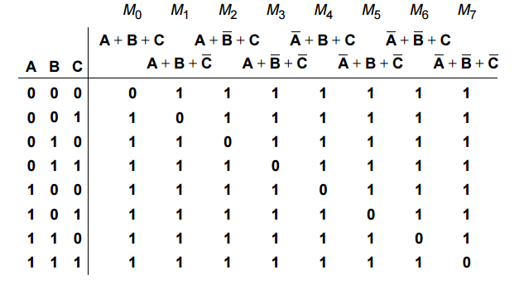
Maxterms
The following table gives the maxterms for a three-input system
Table: Maxterms

Slide 16
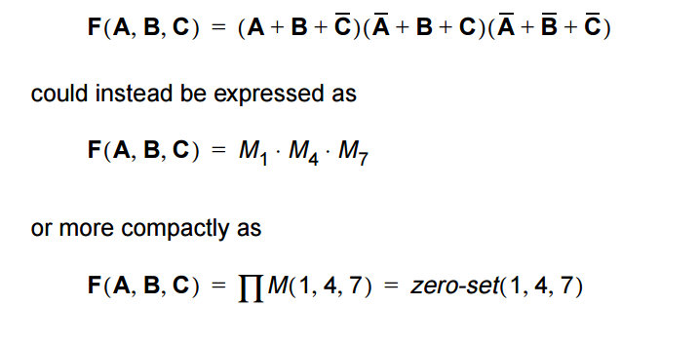
Product of maxterms
Product-of-maxterms standard form expresses the Boolean or switching expression in the form of product of sums using maxterms
For instance, the following Boolean expression using maxterms

Slide 17
Summary
All Boolean expressions, regardless of their form, can be converted into either of two standard forms:
When two or more sum terms are multiplied, the result expression is a product-of-sums (POS)
A standard POS expression is one in which all the variables in the domain appear in each sum term in the expression
A standard sum term is equal to 0 for only one combination of variable values
Product-of-maxterms standard form expresses the Boolean or switching expression in the form of product of sums using maxterms

